Slide 1
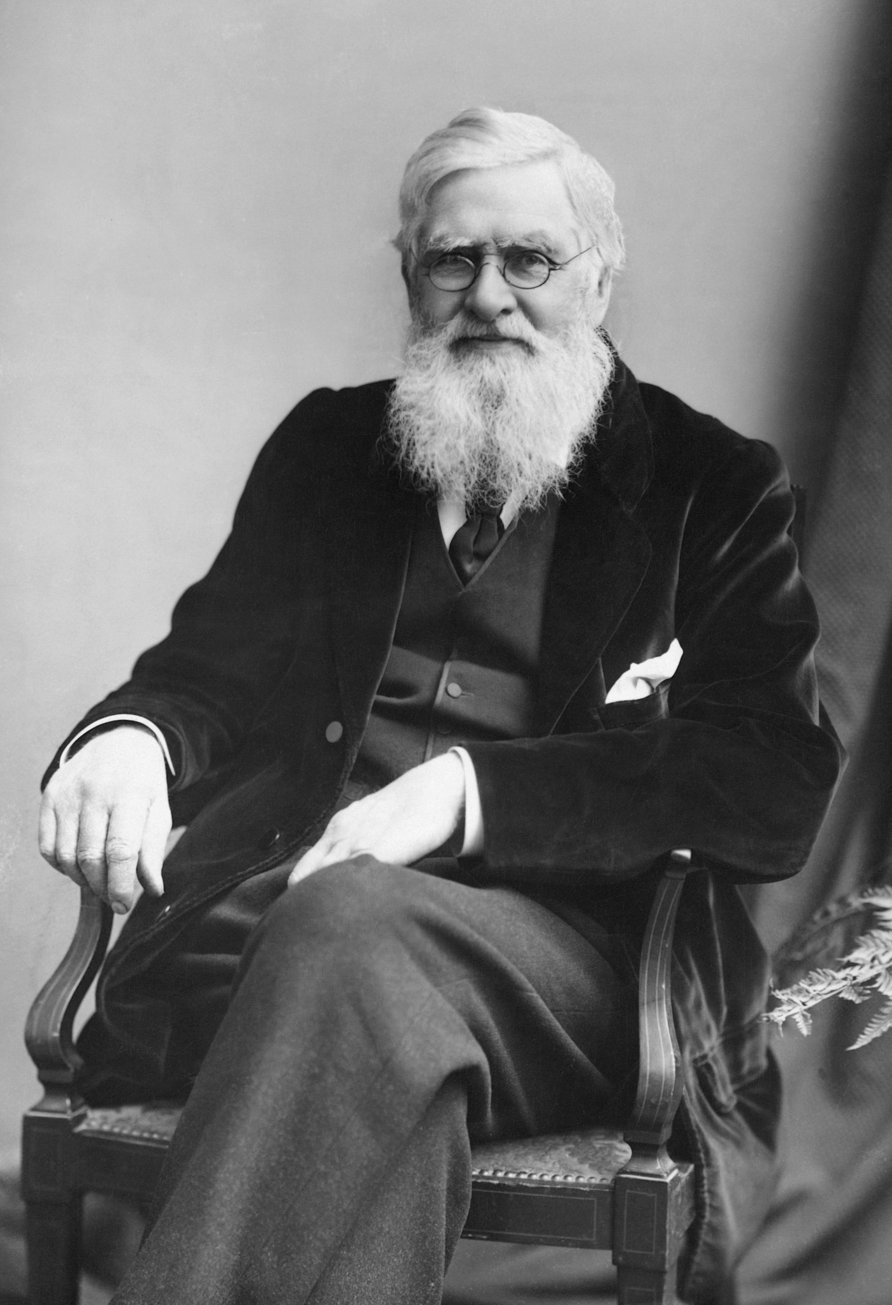
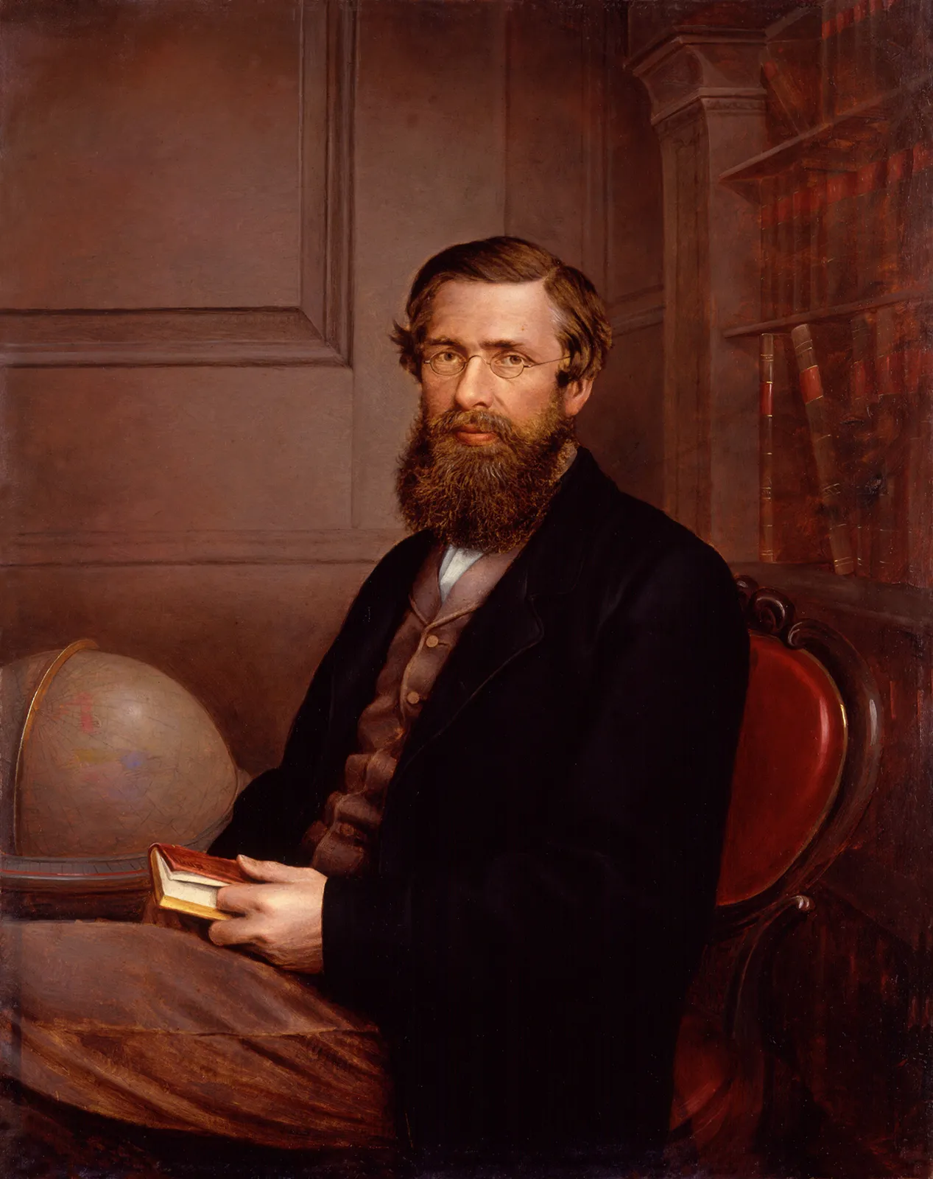

Slide 2
Alfred Russel Wallace
What is his job ?
His clothes :
Favourite thngs :
Appearance:
His family :

Slide 3
Example of a describbling task – Butterfly
The butterfly lives down in the rain forest, near the floor of the rain forest and is sitting on a big green leaf. Above the butterfly three large trees with huge branches are growing. The butterfy is very beautiful, with pale blue wings. On the edges of the wings there’s a dark black line which outlines the wings and a small white spot following it.

